Slide 1
What makes browsers performant
Christian Stockwell
Microsoft Corporation
Notes:
Program manager on the Internet Explorer team
Joined the IE team to work on performance in IE8, have been working on performance for the last 2 years
I work on performance across the platform, the application, and the IE ecosystem
This presentation reflects some of that experience, as well as the compiled experience of many members of the IE team

Slide 2
Topics covered in this talk
How the IE team thinks about platform* performance
How that philosophy has translated into IE8
Specific performance examples
5 minutes of Q & A
Important note: San Francisco is not San Jose. Many thanks to Marla from Fairmont SF and Perla from Fairmont SJ!

Slide 3
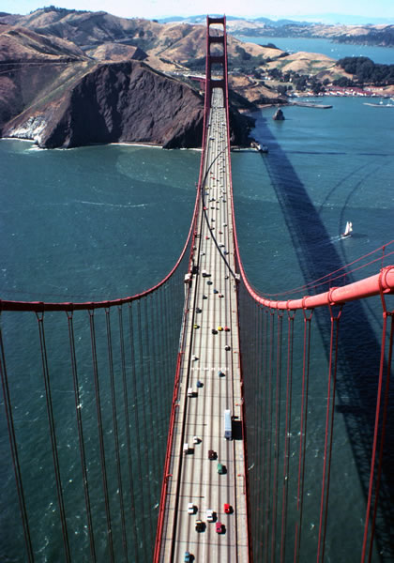

A related example
Consider a flight from San Francisco to Los Angeles
Notes:
Given that I’m the first of three speakers over the next hour and a half, I wanted to spend the first few minutes of my time today taking a step back and talk about the broader context surrounding these talks.
Before delving into the specifics of browser performance I thought it would be useful to start with a similar real world problem. Imagine for a moment that you were an airline CEO and needed to improve total travel time for your customers. Let’s further suppose that you wanted to halve the travel time for someone flying between San Fran and LA.

Slide 4

A related example
One approach:
  Optimize your planes
Notes:
There are several possible approaches that can come to mind. One, certainly, is to start by doubling the power of the engines of the planes in your fleet.

Slide 5

A related example
One approach:
  Double the power of each engine

Slide 6
A related example
What if flying time is only a small part of the total?
  1 hour driving to SFO
  1.5 hours security
  1 hour waiting at the gate
  1 hour flying to LAX
  ½ hour waiting for luggage
  1 hour driving to destination
Notes:
Having doubled the power of each engine… Will this make a big difference? It depends—what if flying time is only a small part of the total travel time? For example if individual travelers spend most of their time travelling to the airport, passing through security, waiting at the gate, or driving to their destination after landing, then doubling the power of your fleets engines may have an almost negligible impact on total travel time. On the other hand, if most travelers are on flights between New York and Shanghai, doubling the power of your fleet’s engines may substantially reduce total travel time.
In the end though, it depends on what a specific traveler is doing.

Slide 7
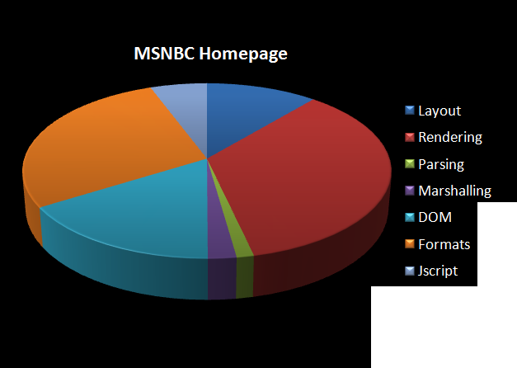
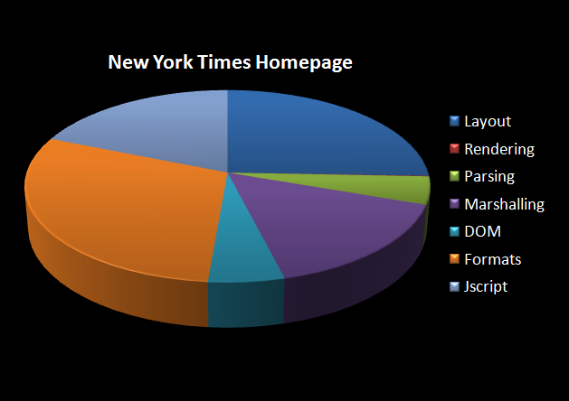
Browsing examples
Notes:
Browsers face similar constraints
Let’s consider two sites doing similar things: MSNBC and the New York Times. Both are relatively rich news sites with worldwide audiences and similar scalability concerns. In IE8 we analyzed both of those pages to identify where CPU cycles were spent when navigating to their homepages.
What you can see is that even though these two sites are very similar in many ways, where the browser spends its time varies greatly between them. For example, you can see that the MSNBC homepages spends a lot of CPU time rendering to the screen, whereas the New York Times homepage spends a lot of time calculating layout, working with the document object model, or marshalling data between the Jscript engine and the document object model.

Slide 8
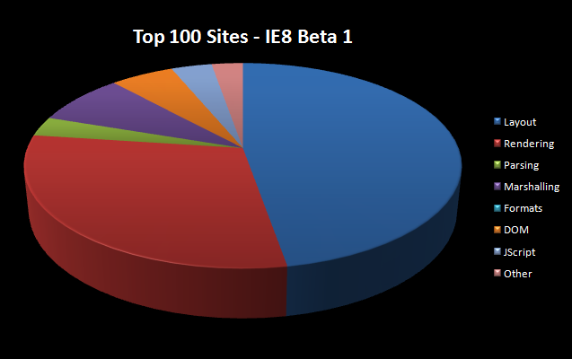
Back to the browser
Let’s expand that to a large number of sites:
Notes:
We can in fact extend that type of analysis across a much broader set of sites. The data on this slide is from IE8 Beta 1. What you can see is another pattern again from what you see on MSNBC and NYTimes, with an entirely different breakdown of CPU usage across browser subsystems.

Slide 9

Back to the browser
Should we double the size of our engines?
Which engines?
Notes:
Having collected this type of data, the IE team was faced with a series of choices to make when we started to look at how we could improve IE. More to the point, since software development is often about making informed tradeoffs, we had to decide where we could get the biggest performance bang for our development buck.
For example, suppose we invested all our effort in Jscript, and reduce the cost of all Jscript operations to 0. Even at that unrealistic limit you can see that although MSNBC users may have a substantially better experience, NY Times users wouldn’t benefit very much. Similarly, users across the top 100 pages would have a muted impact from solely investing in Jscript performance.
A similar tradeoff would exist if we reduced rendering cost to zero—some sites, like MSNBC, would benefit a lot, whereas others wouldn’t benefit at all.
As a result, the only rational investment for the IE team was to invest across the browsing pipeline.

Slide 10
Internet Explorer 8
IE8 delivers broad improvements across the browser
IE8 balances improvements to existing APIs with new, faster APIs
Let’s talk about how our approach has lead to improvements to layout, jscript, networking.
Notes:
Recognizing that, IE8 delivers broad improvements across the browser. IE8 also balances improvements to existing APIs and sites with new APIs and features that allow web developers to significantly improve their sites.
For the remainder of this talk I’ll discuss some of the improvements we made in IE8.
Since the real goal of all this work is to deliver real great web performance, and the IE team sees performant browsing as a partnership between browser makers and web developers, so as I go through the remaining of this presentation I’ll be calling out a few examples of how web sites can improve performance even more on top of what they’ll get from IE8 by default.

Slide 11
Internet Explorer 8 - Layout
Complexity and workarounds are performance killers
IE8 delivers the most complete CSS2.1 platform
Optimized common scenarios:
  Complex selectors
  Expressions
Tips for even faster sites:
  Use class or ID-based selectors
  Use child instead of descendent selectors
  Minimize layout calculations

Slide 12
Internet Explorer 8 – Layout
Simplying complex selectors with ID selectors:
  table tr td ul li { color: green; }
  li#pass { color: green; }
  Using child selectors instead of descendent selectors:
  ul li {color: purple; }
  ul > li {color: purple; }

Slide 13
Internet Explorer 8 - Layout
Examples: Batch layout changes
Two layouts:
document.myDIVid.width += 20;
document.myDIVid.height += 20;
One layout:
var w = document.myDIVid.width + 20;
var h = document.myDIVid.height + 20;
document.myDIVid.width = w;
document.myDIVid.height = h;

Slide 14
Internet Explorer 8 – JScript
IE8 is faster than IE7 overall, particularly for common string and array operations (both >100x faster!)
Built-in JavaScript profiler
Selectors API
  querySelectorAll alternative to getElementByID
  Faster multi-element retrievals

Slide 15
Internet Explorer 8 – JScript
function Validate() {
// Retrieve required elements
var reqs = document.querySelectorAll(“.required”);
// Validate form data
for(var i=0; i<reqs.length; i++) {
if(reqs[i].value == “”)
ReportError();
}
}

Slide 16
Internet Explorer 8 – JScript
JSON
  With eval?
  With custom library?
  Native JSON in IE8!
    No tradeoff between performance and security
    JSON.parse(), JSON.stringify()
    toJSON on Date, Number, String, and Boolean prototypes
Notes:
Eval:
Less secure, requires new execution context (slow)
Custom library:
More secure, but even slower…

Slide 17
Internet Explorer 8 – Network
Network costs still dominate for many sites
  IE8 raises connection limit from 2 to 6
  Parallelized script downloads
  Data URLs
YSlow, VRTA, Page Speed: Still very valuable tools for building fast sites

Slide 18
Bringing it all together
Making real sites faster means improving browser subsystems and also how they connect together
We’ve invested broadly to improve real sites for real users
Our philosophy has made IE8 the fastest browser for many of today’s sites

Slide 19
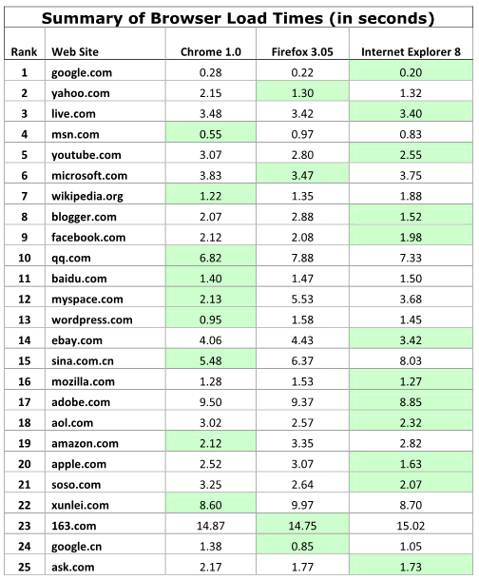
IE8 Performance at RTM

Slide 20
Q & A
Next up: Mike Belshe, Chrome
  UI Performance: Designing and Engineering Time: The Psychology of Time Perception in Software by Steve Seow

